Slide 1


Load Management
Shipboard Power System Fundamentals
Revision of 5 February 2026
Dr. Norbert Doerry
http://doerry.org/norbert/MarineElectricalPowerSystems/index.htm
© 2026 by Norbert Doerry
This work is licensed via: CC BY 4.0 (https://creativecommons.org/)

Slide 2
Essential Questions
What is load shedding and why is it done? | Understand
What are QOS Load Shedding and Mission Priority Load Shedding? | Remember
What are Emergency Loads, Vital Loads, Semi-Vital Loads, Non-Vital Loads? | Remember
How is load shedding implemented? | Understand

Slide 3
Load Shedding
Under normal conditions, sufficient power is generated to serve all online loads.
  Load shedding is reserved for abnormal situations.
Occasionally, power system may not have sufficient online generation to serve all online loads.
  Due to Equipment failure or circuit protection.
  May be ship-wide or restricted to a portion of the distribution system.
Insufficiency of generation must be corrected quickly.
  Generators can tolerate overloads for only a short period of time.
  Eventually generators will slow down, causing a decrease in frequency.
  Once frequency falls below a specified value, a generator will trip offline.
  Power electronic converters typically current limit when overloaded, then shuts down.
Load shedding forcibly removes sufficient load so that the online generation capacity is greater than the remaining load.
  Loads are shed while a standby generator set is brought online.
  Power is restored to shed loads when sufficient generation capacity is online.
Energy storage with sufficient energy and power capacity may reduce the number of loads shed.

Slide 4
Mission Priority Load Shedding
Historically, load shedding has been implemented in one or more stages based on the priority of loads meeting the ship’s mission.
Common load shedding stages are based on assigning loads to specific categories:
  Non-vital – shed in the first stage; loads that do not contribute to the ship’s missions.
  Semi-vital – shed in the second stage; loads that contribute to the ship’s mission but can be shed without losing a basic level of capability.
  Vital – not shed at all; includes emergency loads and most mission critical equipment. Emergency loads are defined in 46 CFR Chapter I subchapter J part 112, subpart 112.15 for commercial ships and DPC 310-1 for naval ships.
Modern controls enable dynamic assignment of loads to mission priority load shedding stages based on the operational condition.
  More than three load shedding stages may be defined.
In ships with an Integrated Power System (IPS), unless in restricted maneuvering, or operating at very load speeds, sufficient propulsion power can usually be shed to preclude having to shed other loads.

Slide 5
Quality of Service Load Shedding
With modern controls, it may be possible to shed sufficient long-term interrupt loads without a service interruption as long as power is restored to these loads within the generator start time (t2).
  If shedding long-term interrupt is not sufficient, then low mission priority short-term interrupt and uninterruptible loads are also shed.
Strategy is to base load shedding on QOS until approaching time t2 when load shedding switches to mission priority load shedding.
  Lower mission priority loads that are short-term interrupt or uninterruptible are shed.
  Power to higher mission priority loads that are also long-term interrupt loads are restored.

Slide 6
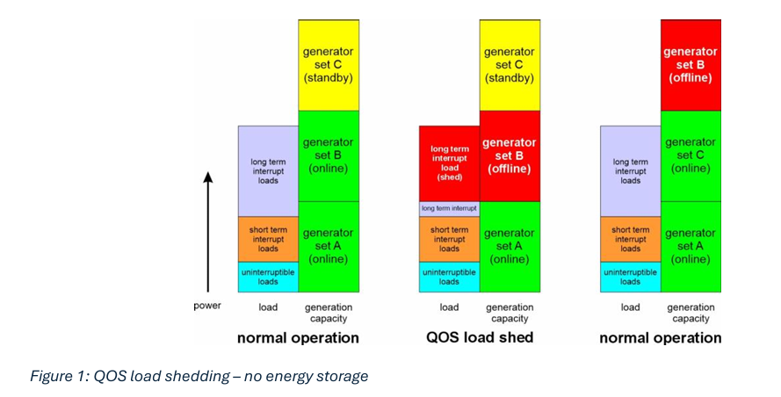
QOS load shedding – without energy storage

Slide 7
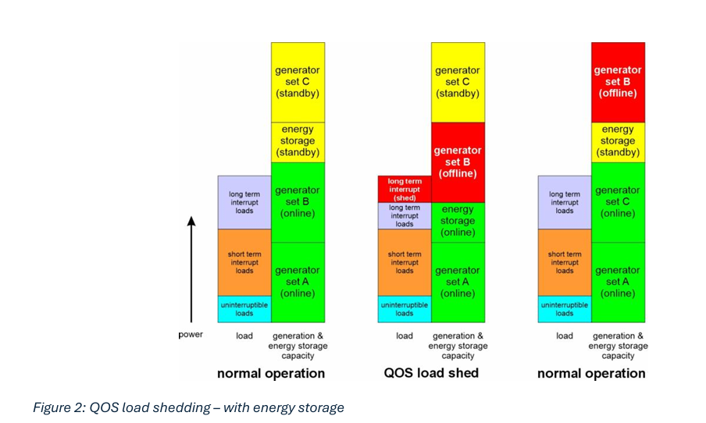
QOS load shedding – with energy storage

Slide 8
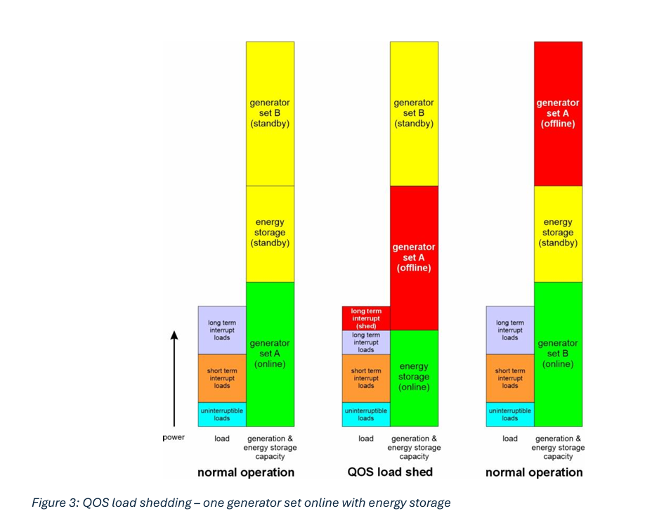
QOS load shedding – one generator set online with energy storage

Slide 9
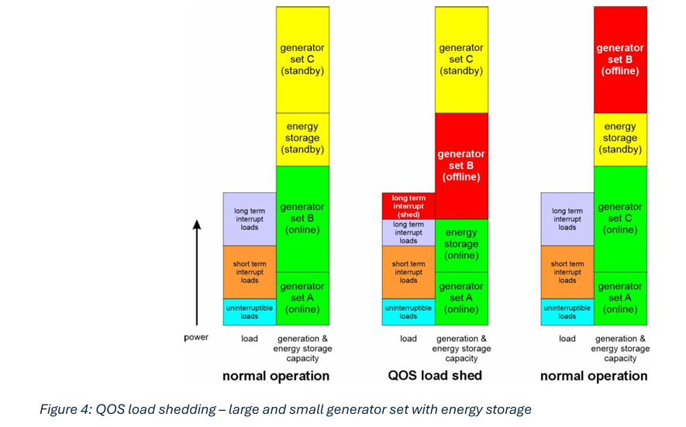
QOS load shedding – large and small generator set with energy storage

Slide 10
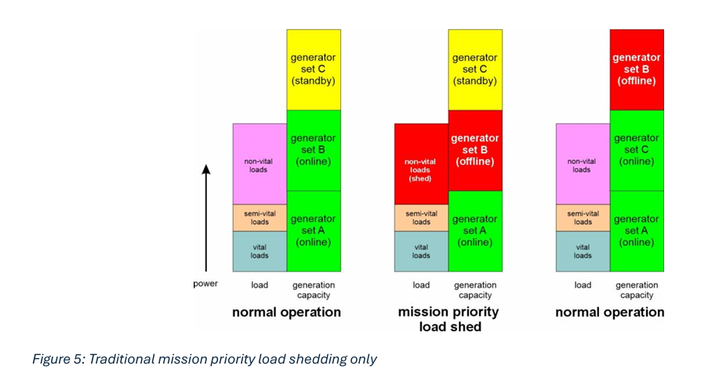
Traditional mission priority load shedding

Slide 11
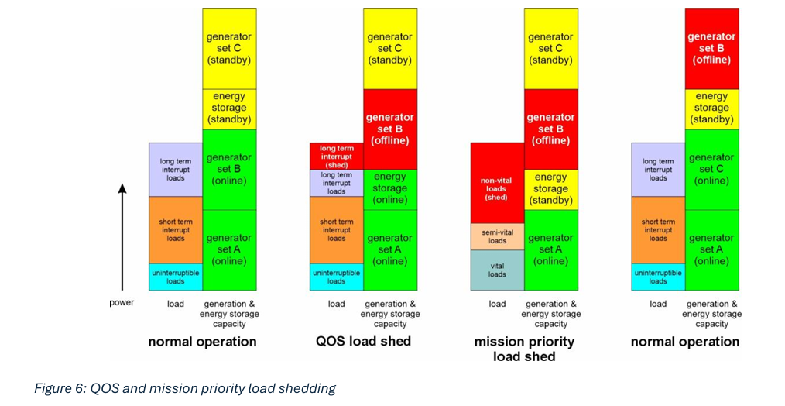
QOS and mission priority load shedding

Slide 12
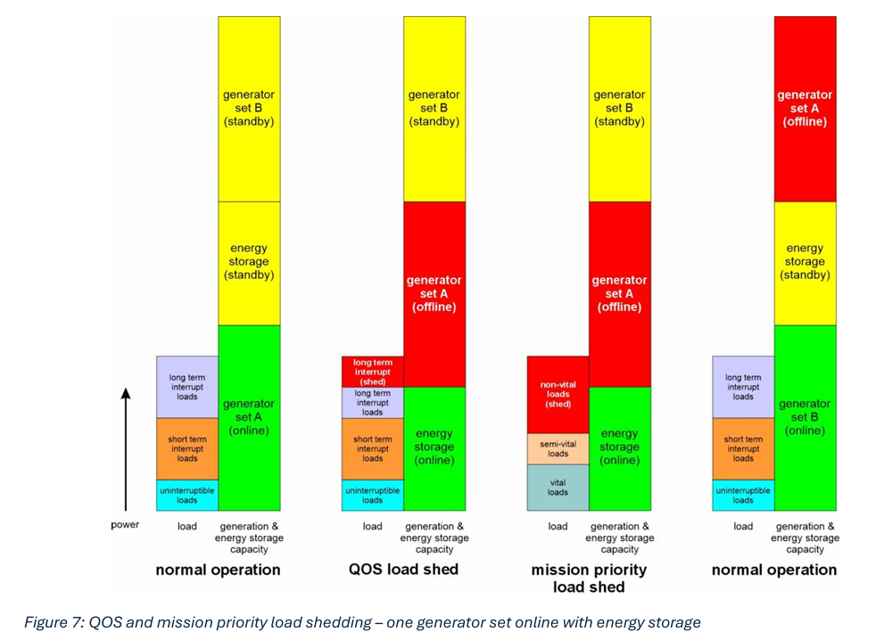
QOS and mission priority load shedding – one generator set online with energy storage

Slide 13
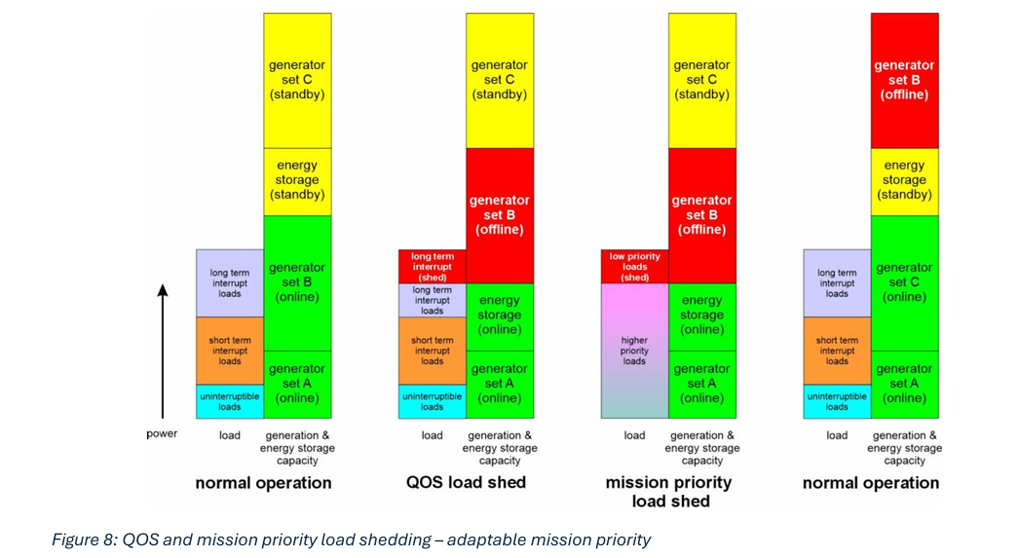
QOS and mission priority load shedding – adaptable mission priority

Slide 14
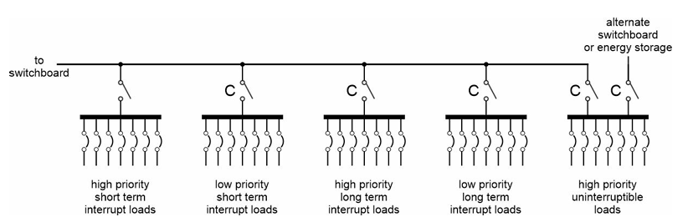
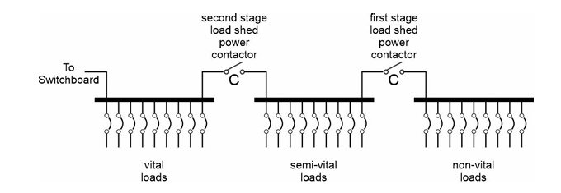
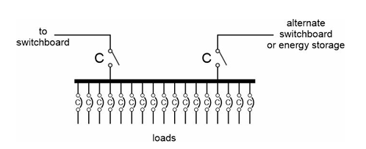
Load shedding implementation
Traditional mission priority load shedding
Traditional mission priority load shedding with QOS load shedding
Controlled breaker load shedding

